Slide 1
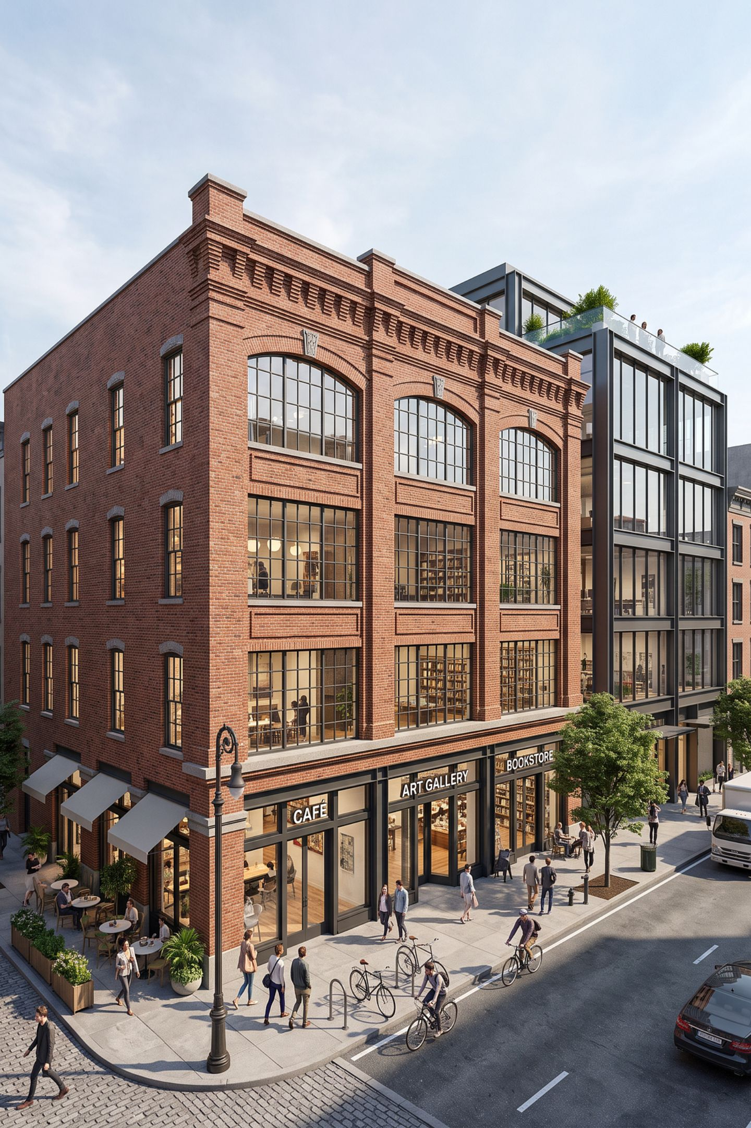
Infill on the Blue Mile: 401 South Main Street
Planning vision, proposed reuse, and project allowances

Slide 2
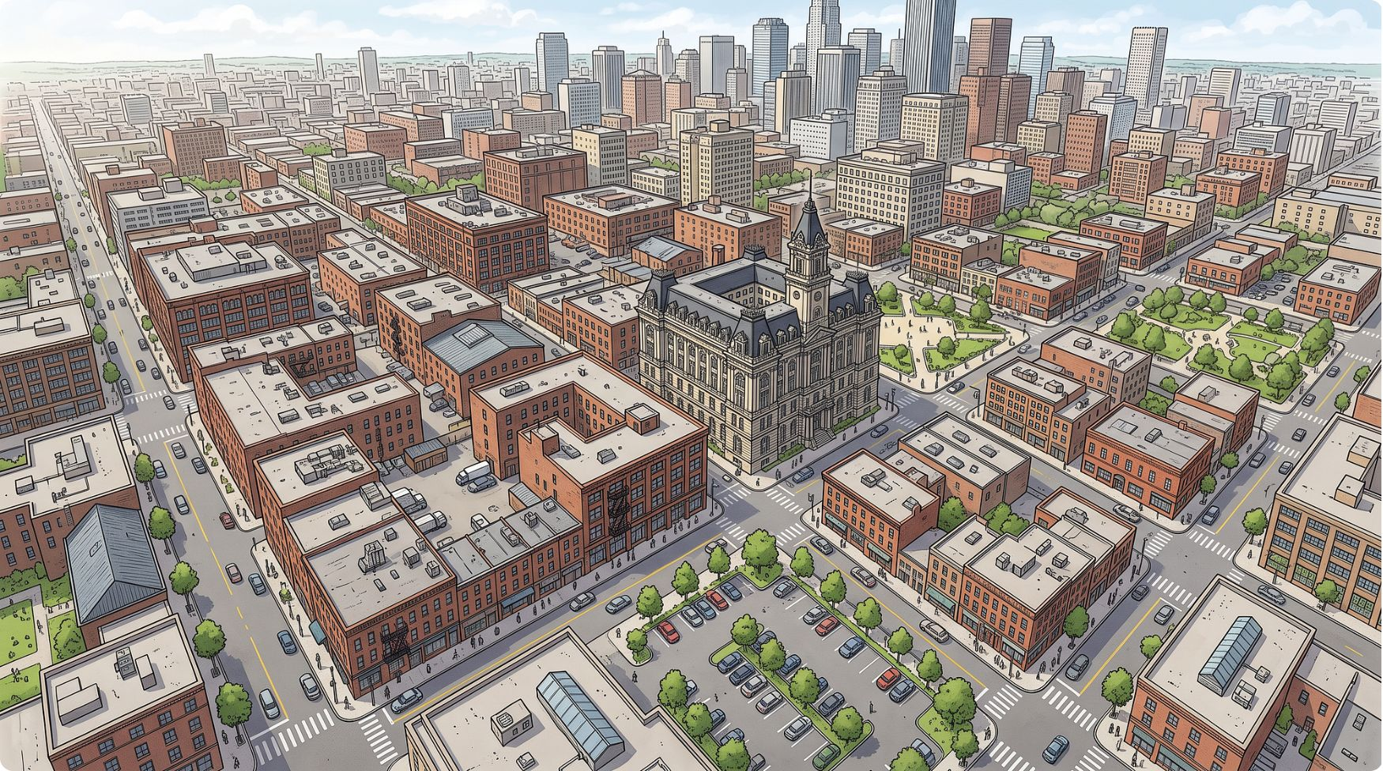

Why Infill Matters
Infill adds activity on already developed or underused downtown land, supports walkable street connections and businesses, and can retain existing architectural assets.
The 2022 Downtown Statesboro Master Plan identifies the Blue Mile as a spine for varied infill linking the Square to the university. Its housing guidance encourages compatible new buildings and rehabilitation of existing structures.
The older 2014 South Main TAD Redevelopment Plan likewise calls for pedestrian-friendly mixed-use redevelopment and adaptive reuse where possible.
2022 Master Plan
2014 TAD Plan
Shared Vision
Blue Mile as infill spine; compatible new buildings and rehabilitation encouraged along the corridor from the Square to the university.
Pedestrian-friendly mixed-use redevelopment and adaptive reuse called for within the South Main Tax Allocation District.
Both plans frame infill as a tool to reconnect downtown destinations — not as a commitment to approve any specific proposal.

Slide 3
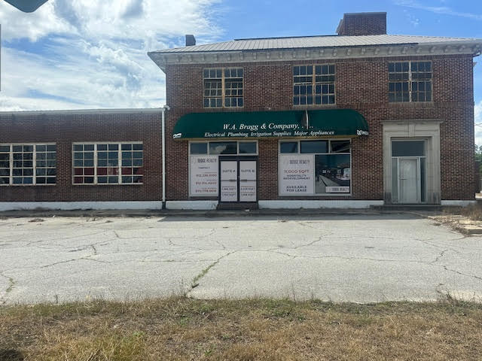
A Real Site: 401 South Main Street
SITE OVERVIEW
Five Parcels · 7.54 Acres · Blue Mile Overlay
The site spans the South Main / West Brannen / South College area in the heart of the Blue Mile Overlay district.
Historic Assets
Environmental Constraints
Former bottling-company site with a historic 1920 brick warehouse and a historic house on the parcels.
Report identifies a floodplain/floodway and wetlands present on portions of the site requiring review.

Slide 4




What the Applicant Proposes
Restaurant & Brewery
Proposed in the historic 1920 warehouse fronting South Main Street — adaptive reuse of the existing brick structure.
Apartment Buildings
Four apartment buildings with approximately 108 units / 240 student-housing beds proposed along South College.
Historic House
Maintaining the historic house as a marker, allowing for the application of historic tax credits.
Amenities
Clubhouse, outdoor dining, and a proposed walking trail along the railroad corridor are included in the proposal.

Slide 5
Allowances Are Paired with Standards
Staff compared the proposal against applicable PUD mixed-use and Blue Mile Overlay standards. The table below reflects staff-report comparisons — not an independent legal determination.
Standard | Requirement | Proposal (per staff report)
PUD Mixed-Use: Residential component | At least 20% residential | Meets standard per staff report
PUD Mixed-Use: Nonresidential component | At least 20% nonresidential | Meets standard per staff report
Blue Mile Overlay: Building height | Five-story maximum (rooftop deck allowance) | Three stories proposed
Blue Mile Overlay: Amenity space | Five-percent amenity space requirement | Proposed as met per staff report

Slide 6
Site Design and Safeguards
Infill needs infrastructure and site-specific review. The staff report identifies several practical considerations that shape what can be built and when.
Access Points
Utilities
Four access points are proposed: two on West Brannen Street and two on South College Street.
Water and sewer availability has been noted; utility adjustments remain subject to final engineering review and approval before construction.
Floodplain, Floodway & Wetlands
GDOT Roundabout / Right-of-Way
The report identifies floodplain/floodway and wetland areas on portions of the site. These environmental constraints require site-specific review and may limit buildable area.
Planned GDOT roundabout and right-of-way changes could affect site design. These external factors are outside the applicant's direct control and may require design adjustments.

Slide 7

What This Example Illustrates
The 401 South Main Street proposal demonstrates how infill planning works in practice — and what remains distinct at each stage.
Infill Vision in Action
Project-Specific Allowances
Conditions and Later Reviews Remain Distinct
Linking new housing with active reuse of a historic warehouse can advance the infill vision along the Blue Mile, connecting the Square to the university as both the 2022 Master Plan and 2014 TAD Plan envision.
These are distinct from the broader planning goals, they address this site's particular constraints and proposed uses. This project achieves not only the retention of historic property, but provides downtown living opportunities.
Conditions attached to a recommendation, and the building-plan reviews that follow any approval, are separate steps. In this PUD, we have achieved a distinct layout.

Slide 8
Questions?

