Slide 1
More Than a Market
How Partnerships and Tourism Product Development Transformed a Derelict Warehouse
Justin Samples | VP of Marketing & Operations, Visit Statesboro

Slide 2
You're sitting in the project
So instead of showing you what it looks like now, I'll show you what you can't see.

Slide 3
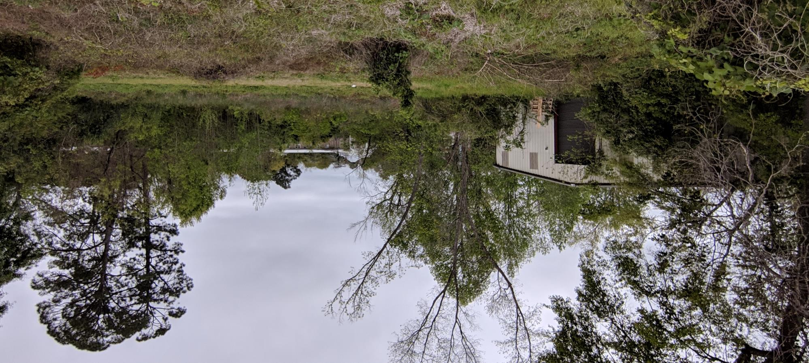
What was here before
BEFORE VIDEO: walk-through of the packed warehouse
60 × 125 ft | 7,500 sq ft
No road access

Slide 4
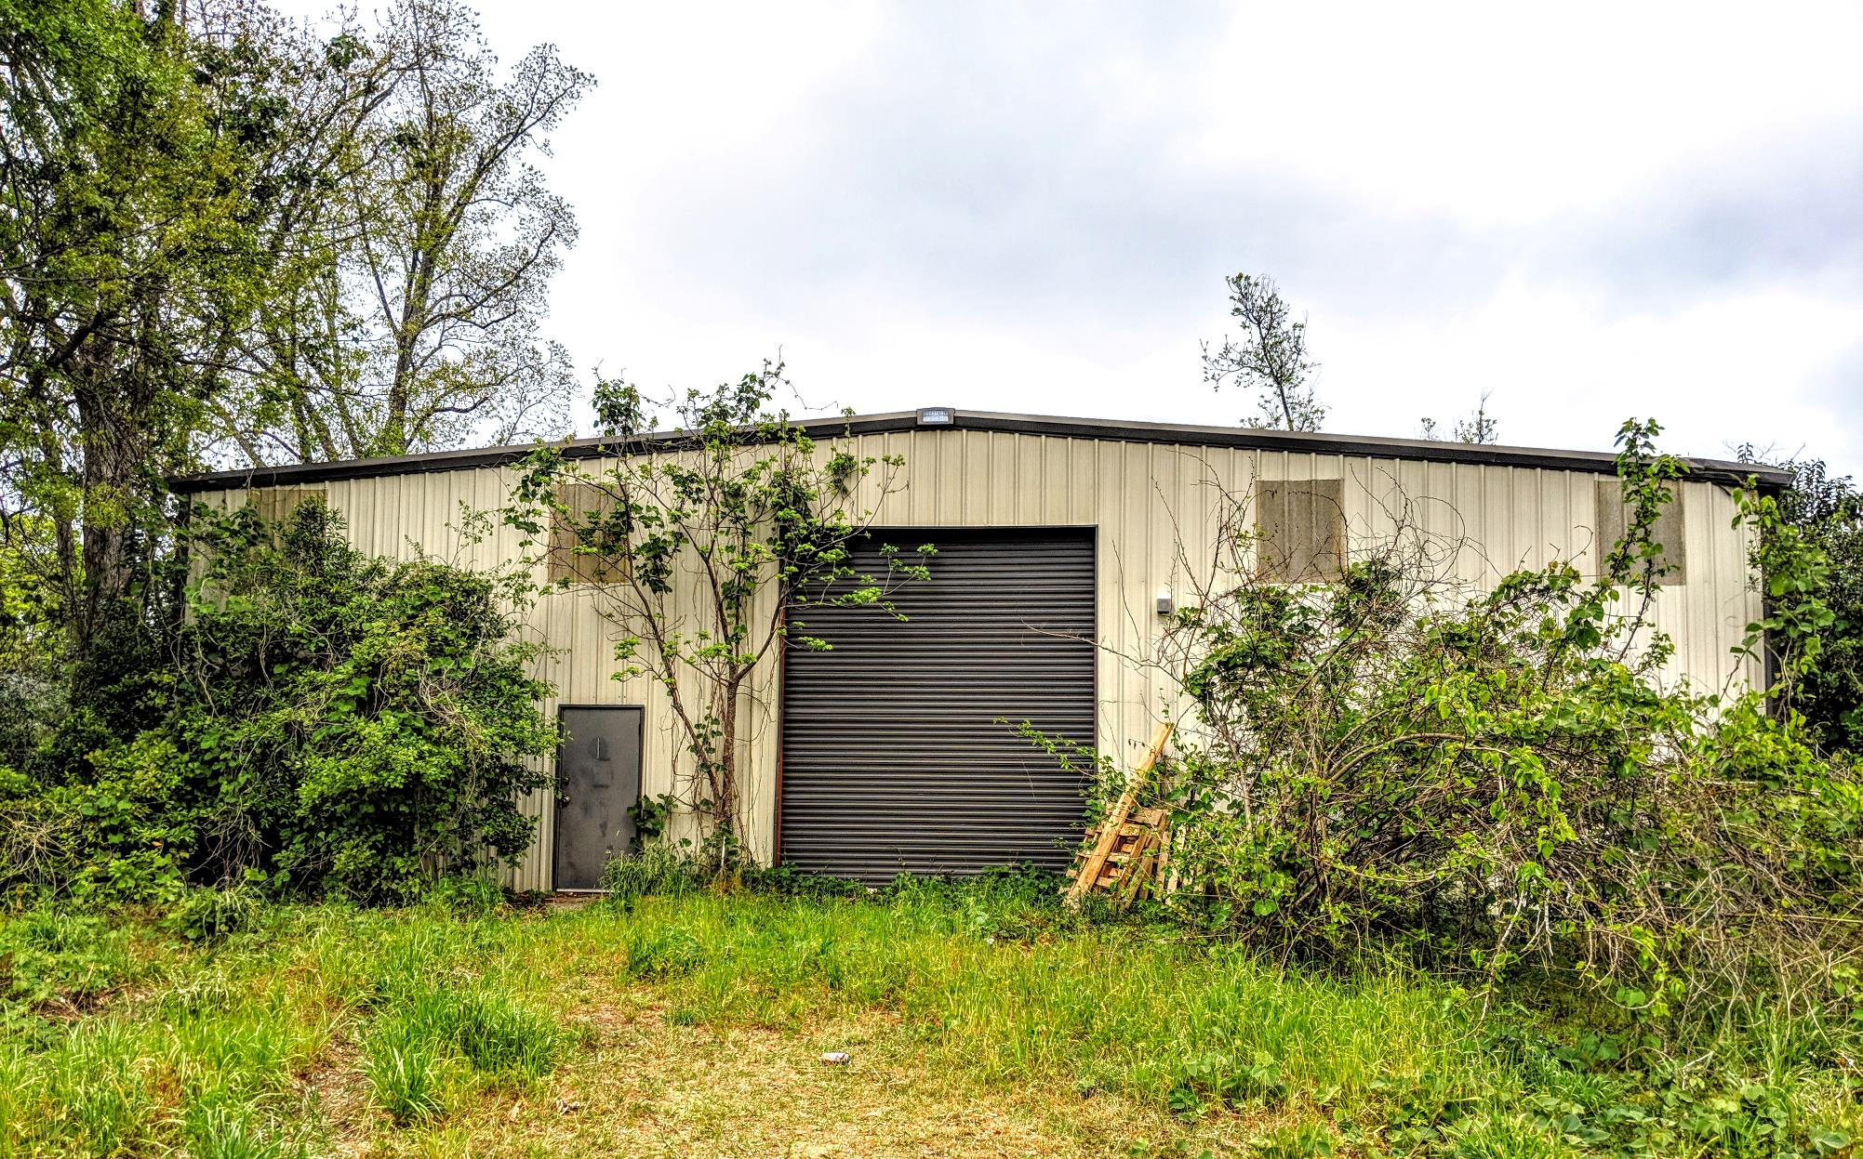
Half swallowed by vegetation

Slide 5
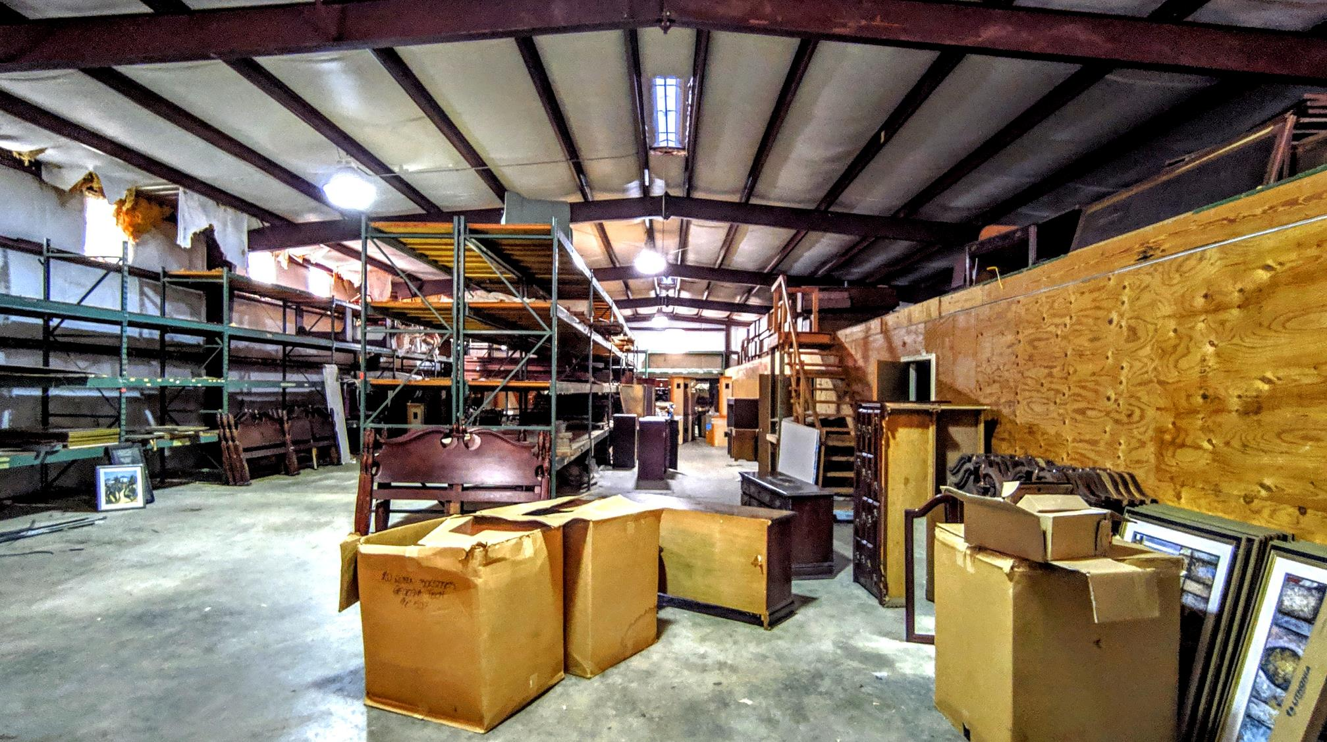
Hotel furniture, floor to ceiling

Slide 6
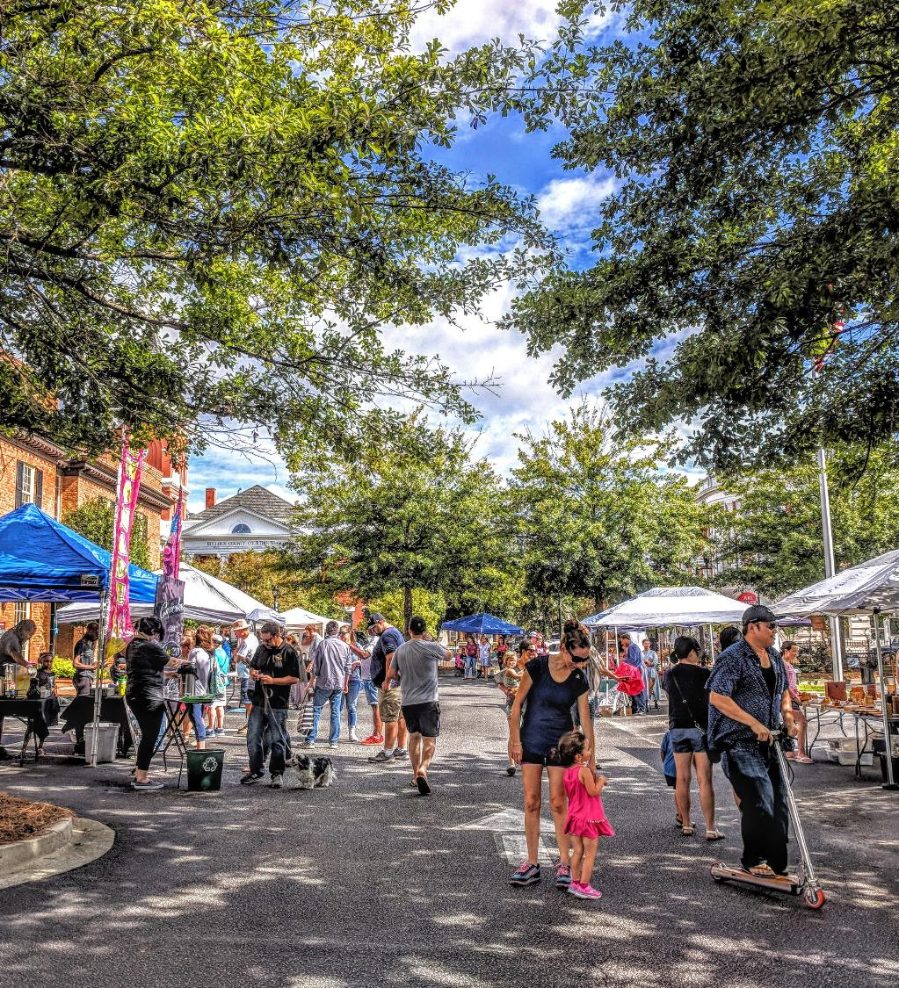
The market had no real home
PHOTO: market at the old bank parking lot
Statesboro Farmers Market met in a bank parking lot
A bad forecast kept shoppers home
Produce vendors couldn't pack back up what they'd set out

Slide 7



What we needed
MUST HAVE
BONUS
BONUS
A covered, permanent market home
Event space
A link to the McTell Trail
The timing: during and right after COVID, when open-air gathering space mattered most

Slide 8
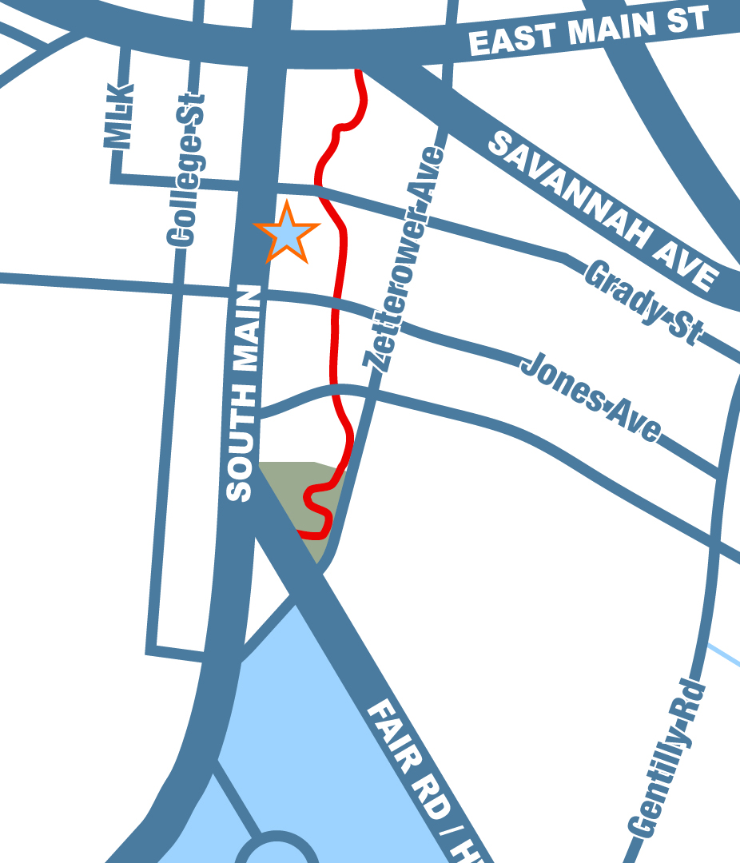
Where it sits
The Blue Mile
About a mile of South Main St (Hwy 301), Georgia Southern to the courthouse
The McTell Trail
About a mile, rec center to downtown, running 600 to 1,000 ft east of South Main

Slide 9
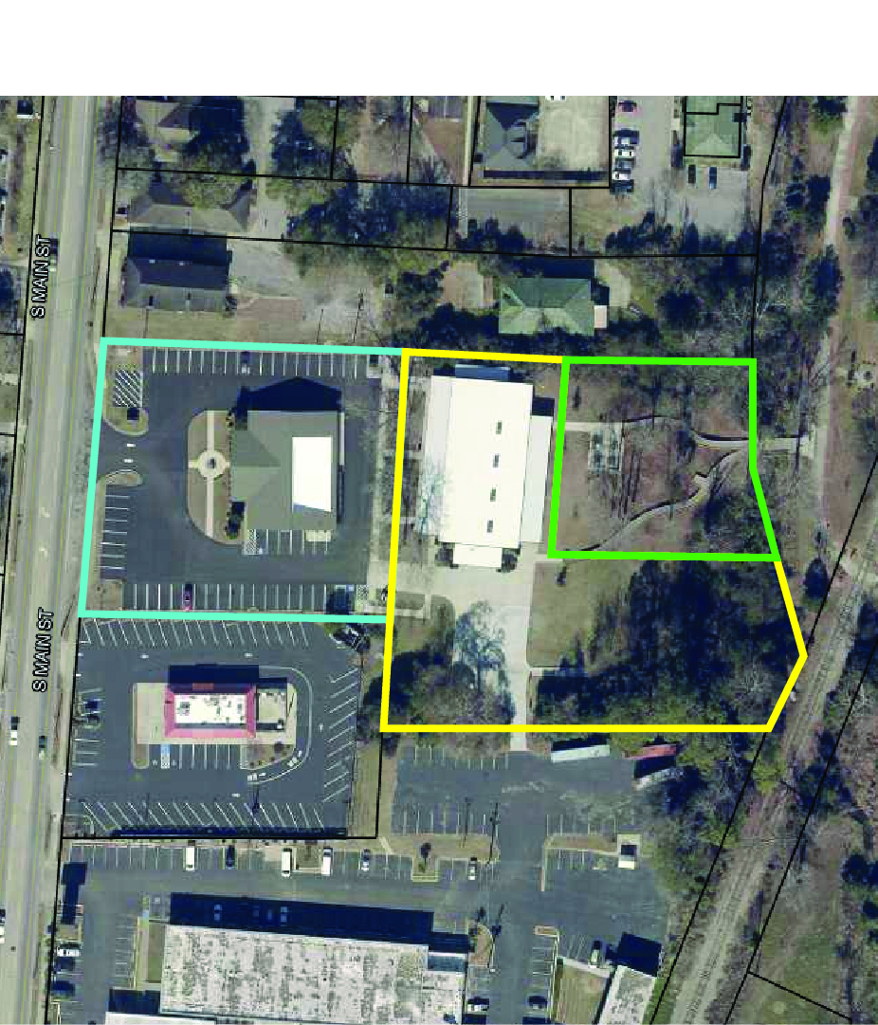
A very awkward piece of real estate
DSDA Lot
L-shaped warehouse lot with no road access
Next door: a square DSDA lot, wet and low
A drainage ditch cut it all off from the trail

Slide 10

Partnership made the site possible
1
2
3
We bought the warehouse
DSDA gave its land
One workable site
Approached the hotel group
$97K, late 2018
Deeded the adjoining lot to Visit Statesboro
Building, land, and room to reach the trail
Access today: Visit Statesboro parking lot, hotel, McTell Trail

Slide 11
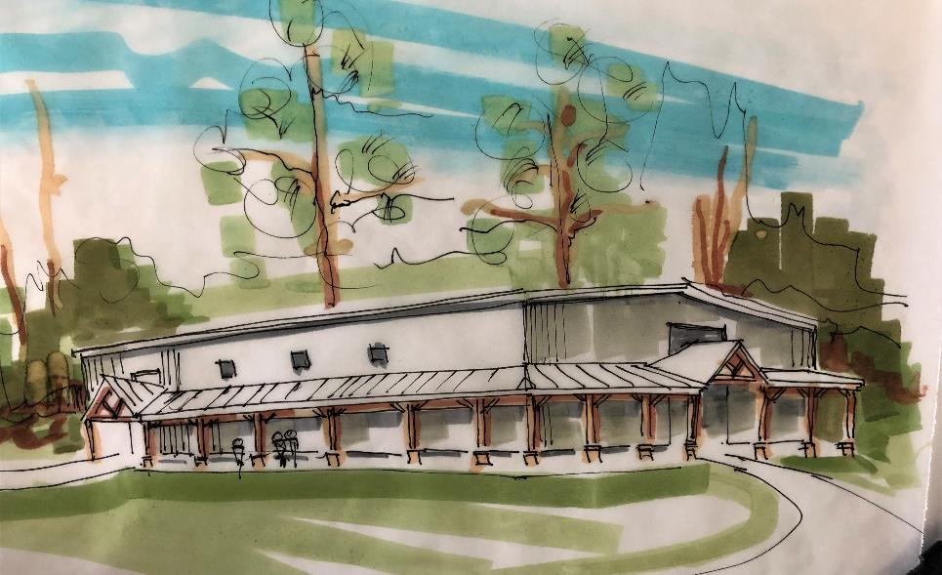
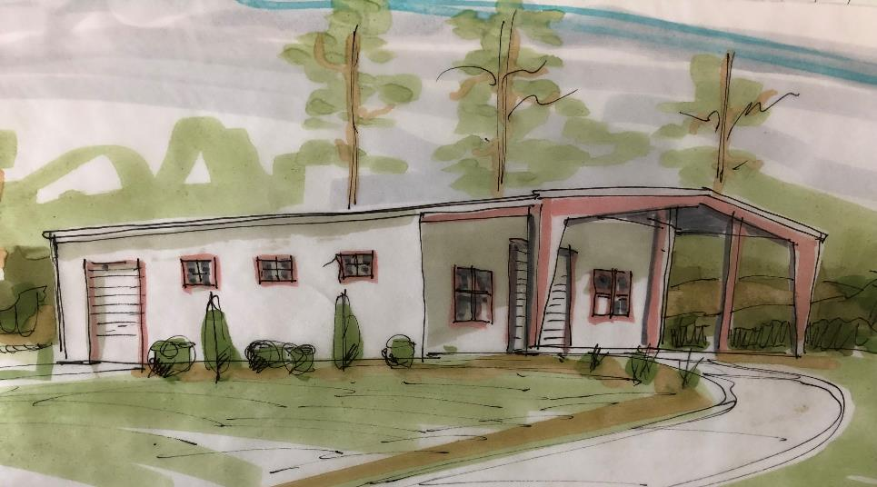
The first ideas:
EARLY CONCEPT: open-air pavilion rendering
Just a pavilion
Strip the walls
Keep the roof and the slab
Then we thought about rain, wind, and summer in Georgia
Exterior details
Add covered walkways
Architectural front entry

Slide 12
So we designed it to be both
An enclosed building when it needs to be.
An open pavilion when it doesn't.

Slide 13
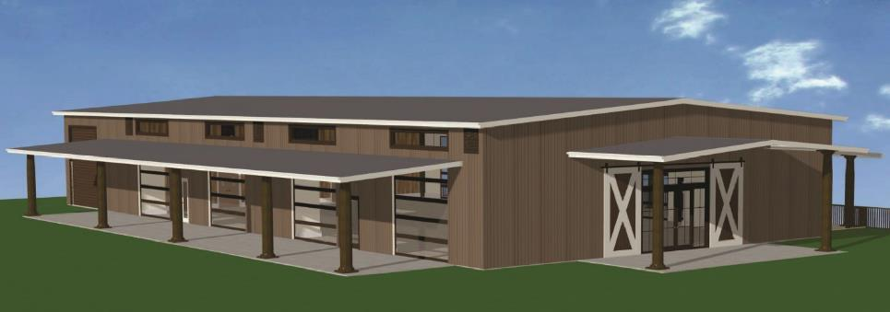
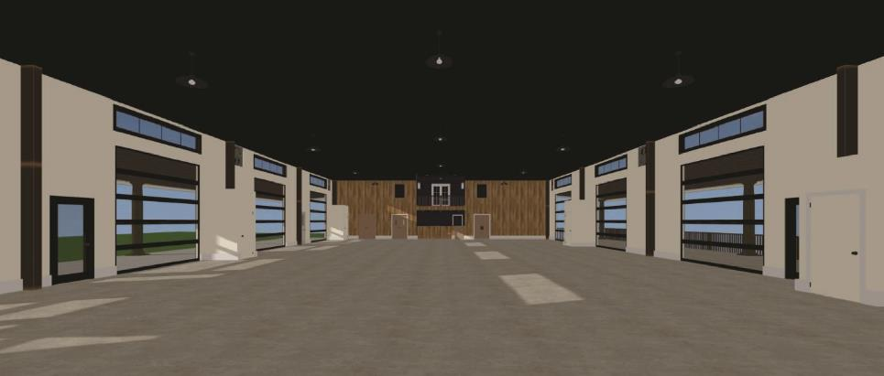
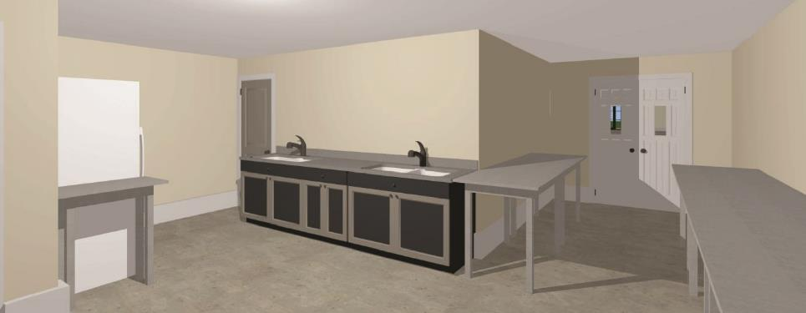
Opening up a warehouse
8
glass roll-up doors
15 ft
covered porches
60 × 100
ft event floor

Slide 14
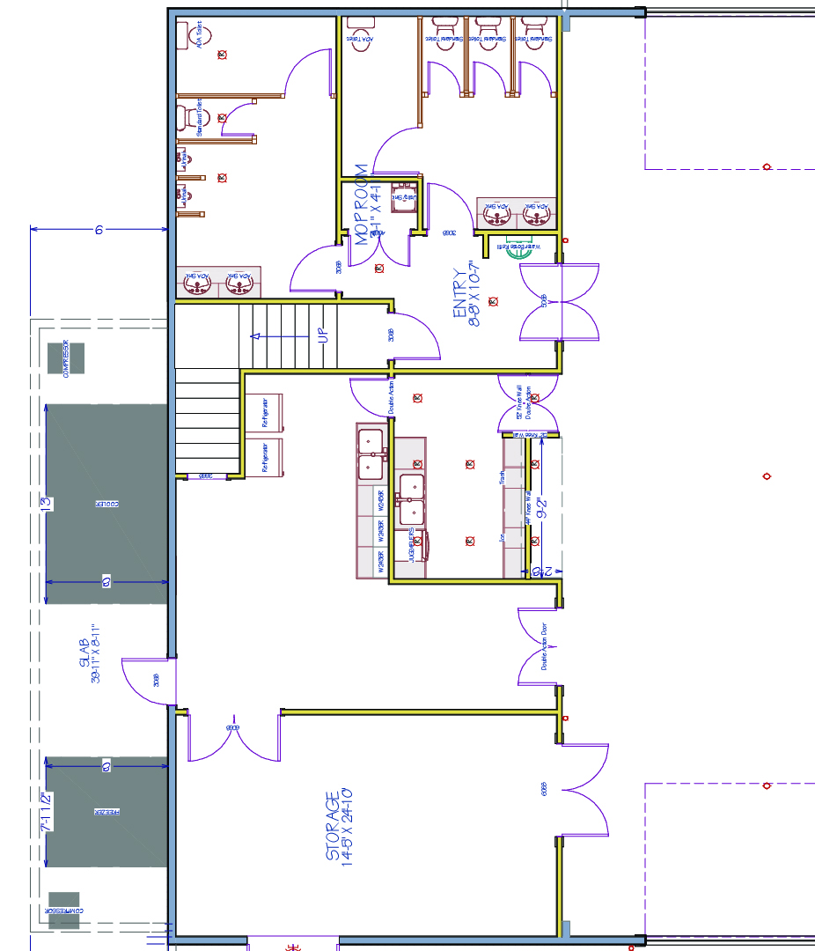
Everything else fits in 25 feet
Restrooms and storage
Catering kitchen, bar, pass-through
Upstairs: meeting room, office, balcony
Outside: walk-in cooler and freezer

Slide 15




Staff designed. Professionally delivered.
Designed
Visit Statesboro staff: CAD plans and 3D renderings
Stamped
Frank R. D'Arcangelo, DPR Architecture
Built
Jamey Cartee, St. Andrew's Builders
Specialists
Lighting, ADA, drainage, ventilation

Slide 16
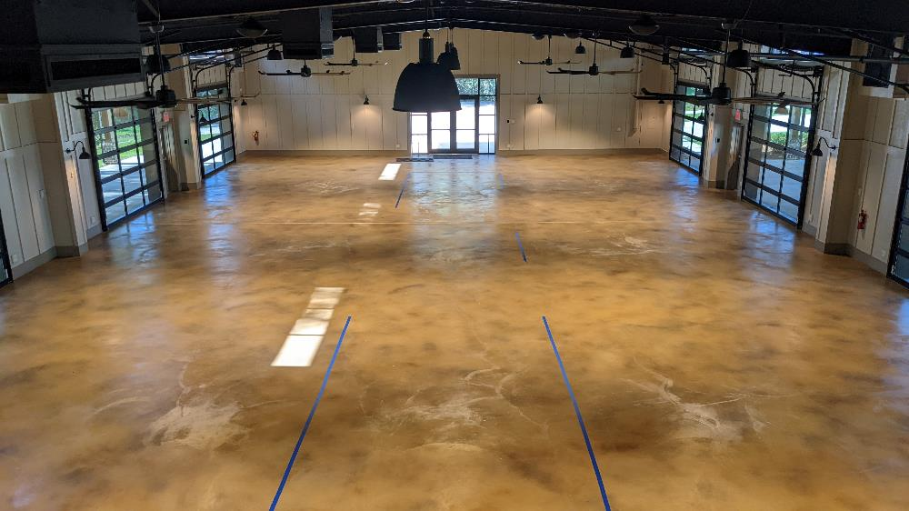
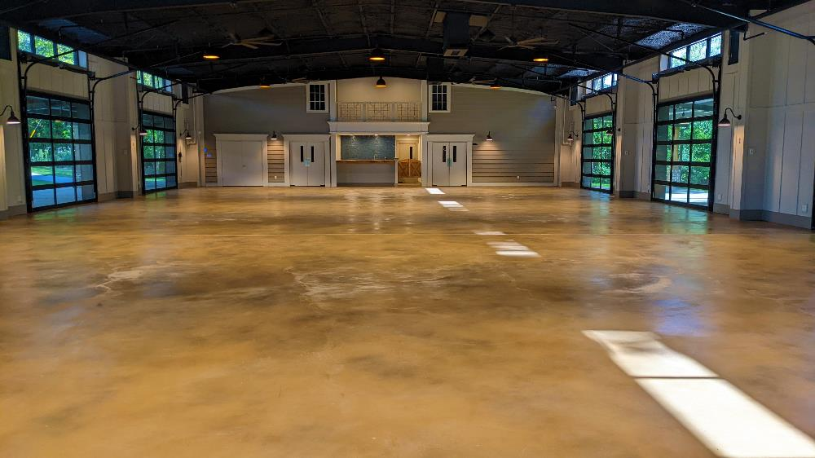
Keeping the pavilion feel
8
ceiling fans
6
high exhaust fans
Look up.

Slide 17
Then the project fought back
The parts that didn't go to plan

Slide 18
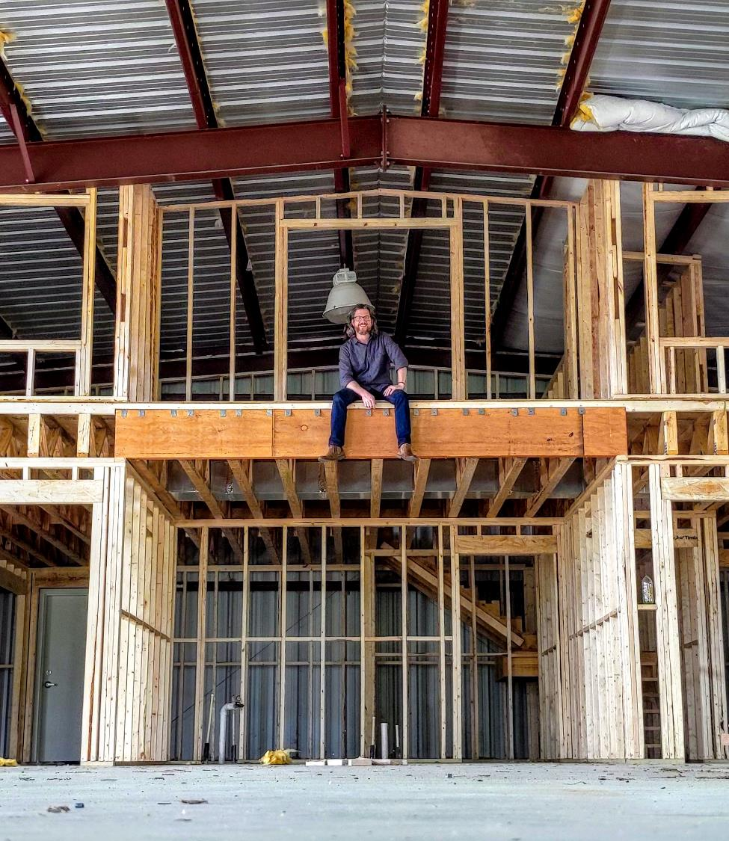
COVID hit cost and schedule
Lumber prices skyrocketed
Most other materials followed
Delays on top of cost increases

Slide 19
The sewer surprise
300+ ft
Downhill meant crossing the railroad
Bored under our parking lot
Installed a large pump system
of wastewater pumped uphill to the Main Street sewer

Slide 20
Water was the other fight
Runoff
New drain lines, a concrete flume, rebuilt gutters, more grates
Walk-in cooler and freezer
Condensation and freeze-ups in Georgia humidity and heat

Slide 21
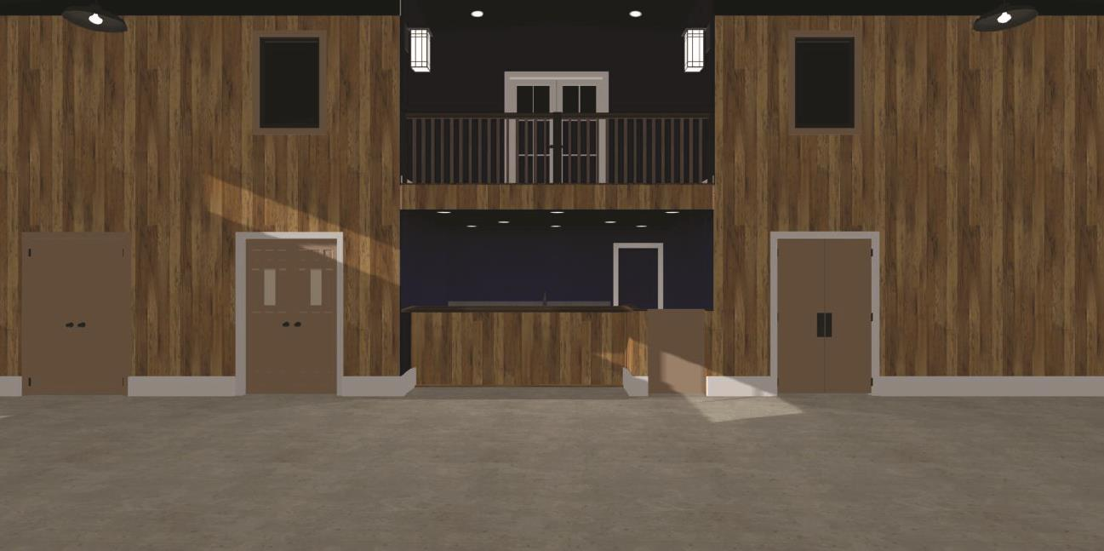
When the craftsmen took ownership
Take a look for yourselves
Board-and-batten became Southern shiplap
Trim built on site
No added cost

Slide 22
Turning a ditch into a front door
Two boardwalks curve through the trees
Two ways in, fewer bottlenecks
A bridge to the McTell Trail
TAD funded, finished early 2023

Slide 23
Not everyone wanted the market to move
The old site was the heart of downtown, by the courthouse

Slide 24
What we heard, and what was true
WE HEARD
THE FACTS
You're taking it out of downtown
There won't be parking
We're in the middle of designated downtown
Bank lot: about 35 spaces. Ours: 52, plus Saturday deals with neighbors

Slide 25
Some arguments you can't win with talking points
We still hear it. The numbers answer it.

Slide 26

And then the market grew
20–25
~57
vendors at the bank lot
vendors per market today
Produce and food vendors now sell most of their product, or sell out

Slide 27
Vendor-reported sales keep climbing
+35%
average weekly sales
2023 full season: $425K+
2024 full season: $639K+
2025 full season: $774K+
2026 $862K+ by September

Slide 28
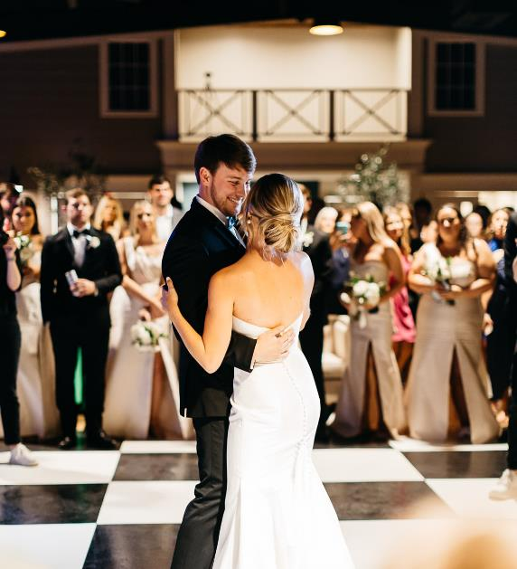
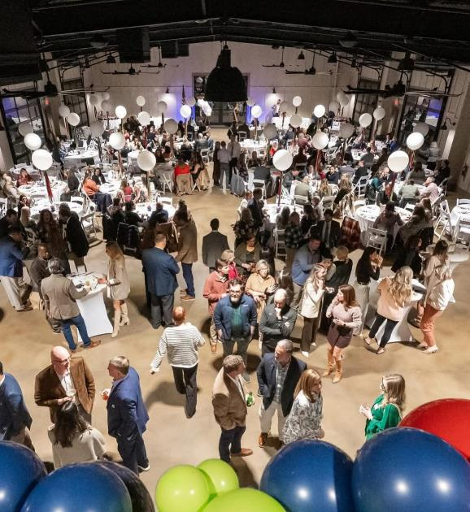
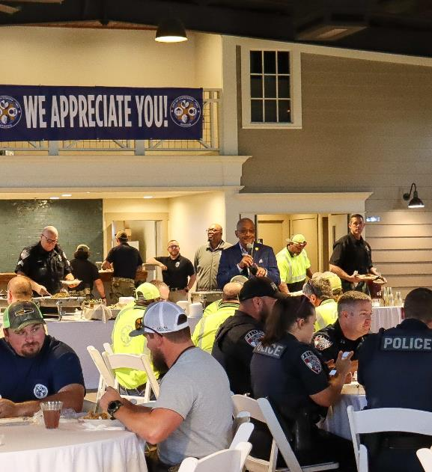
About 60 rentals a year
EVENT PHOTO: wedding or reception
EVENT PHOTO: Greek event or quinceañera
EVENT PHOTO: city, county, or fundraiser
Weddings and receptions
Greek events, quinceañeras
Civic events, fundraisers

Slide 29
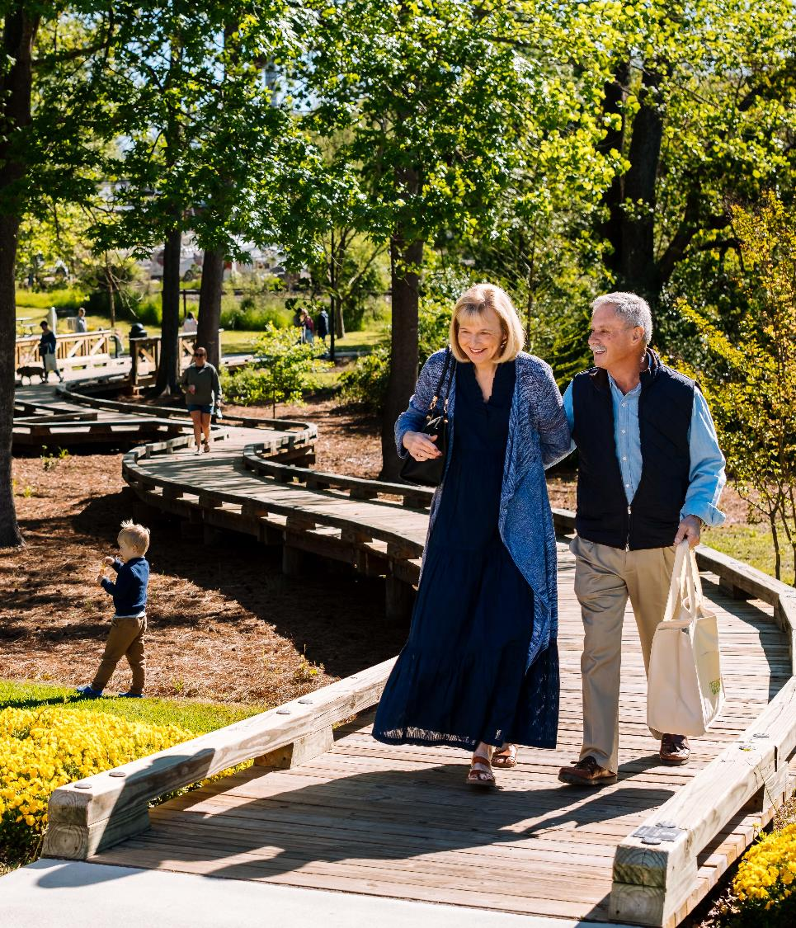
It works even when nothing is booked
PHOTO: picnic area or trail users passing through
Picnic tables and a bench swing
Walkers, runners, families, dogs
Market2Go pickup every Thursday

Slide 30
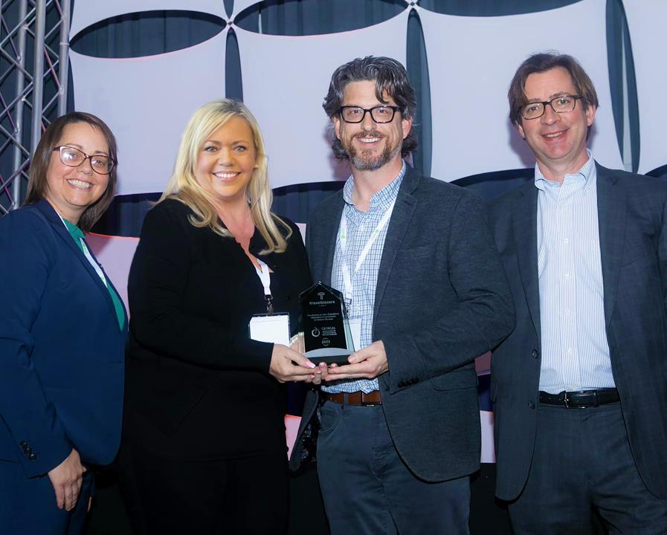
Recognized statewide
2023 TravelBlazer
Georgia Association of Convention & Visitors Bureaus and Georgia Trend
Featured in Georgia Trend, July 2023

Slide 31
From contract to community asset
Late 2018
2018–2019
2021
April 2, 2022
Oct 8, 2022
Early 2023
Purchase contract
Cleanout and lot cleanup
Design and construction begin
First farmers market
First rental event
Boardwalk and bridge done
Construction wrapped the week before the first market

Slide 32
Tourism dollars, community value
Just over $1M
$97K
Purchase
Funded by TPD
~$820K
Construction
Funded by TPD
~$135K
Boardwalk + bridge
Funded by TAD
Land: donated by DSDA TPD: hotel-motel tax set aside for tourism facilities

Slide 33
Tourism money didn't build something just for tourists
It built something for everyone.

Slide 34
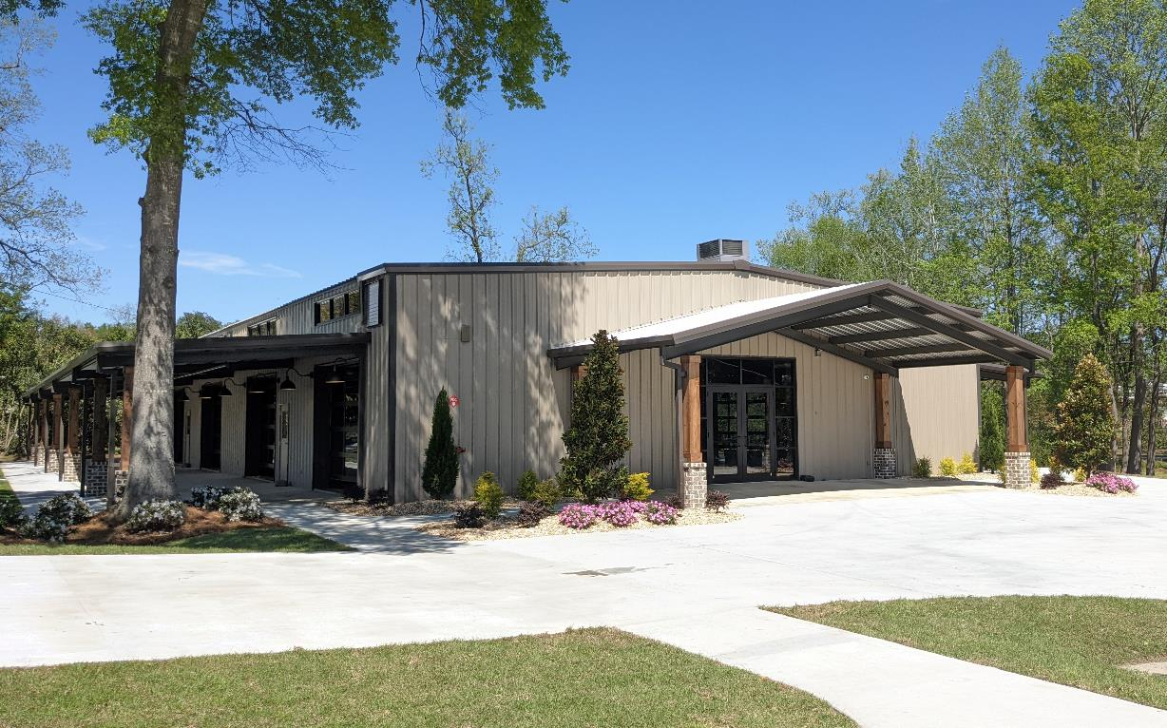
What one project solved
Adaptive reuse
PHOTO: best current aerial or exterior
Blue Mile beautification
Market stability
Trail connectivity
Event space
Downtown activity
Public space
Partnership

Slide 35
Build relationships before you need them
A seller willing to sell. A partner willing to give land.
A fund built for this. Builders who cared.

Slide 36




Thank you. Questions?
Justin Samples
VP of Marketing & Operations
justin@visitstatesboro.org
912-690-4326

